Slide 1
STDIN – STDOUT - STDERR
Container 102

Slide 2
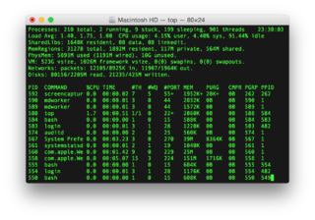
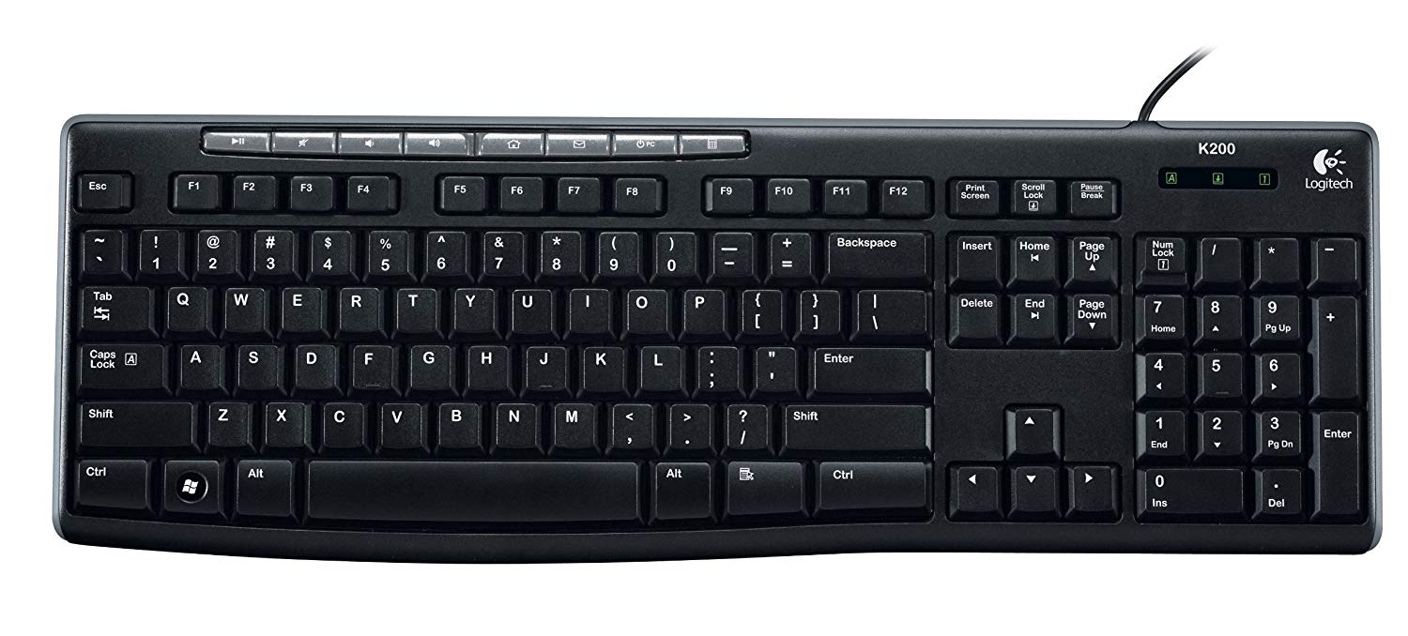

Standard Input-Output-Error
Terminal
stdout (1)
Process
stdin (0)
stderr (2)

